Slide 1
Understanding the importance of spectral energy estimation in Markov Random Field models for remote sensing image classification.
Email: wehmann.2@osu.edu
11 April 2014
Adam Wehmann | Jangho Park | Qian Qian
M.A. Student Department of Geography | Ph.D. Student Department of Industrial and Systems Engineering | Ph.D. Student Department of Statistics
The Ohio State University

Slide 2
Outline
Introduction
Background
Method
Results
Discussion
Conclusions

Slide 3
Introduction
Contextual classifiers use site-specific information to make classification decisions.
  e.g. information from the neighborhood surrounding a pixel
Advantageous to discriminating land cover in the presence of:
  high within-class spectral variability
  low between-class spectral variability
  mismatch between spatial and thematic resolutions
Four main methods:
  Filtering
  Texture Extraction
  Object-Based Image Analysis (OBIA)
  Markov Random Field (MRF) Models
Notes:
site-specific: texture, neighborhood information, statistical moments
WC variability increases as spatial resolution increases
BC variability is related to discrimination problem with similar land cover types (high overlap)
mismatch is related to heterogeneity of landscape

Slide 4
Introduction
Filtering
  increases the ‘sameness’ of data in a local region
  can be applied either pre- or post-classification
  simple, fast, but yields at most marginal improvements in accuracy
Texture extraction
  creates additional features for use during classification
    e.g. statistical moments, Gray-Level Co-Occurrence Matrix (GLCM), neighborhood relations
  can be performed either pre-classification or during it
  aids in discrimination between classes, but increases data dimensionality
Notes:
texture extraction “during”, i.e. contextual kernels

Slide 5
Introduction
Object-Based Image Analysis (OBIA)
  calculates texture and shape-based measures for image objects
  often applied to high resolution data
  typically performed with significant human interaction
  high-performing
Markov Random Field (MRF) models
  models relationships within image structure
    e.g. pixel-level, object-level, multi-scale
  applied to a wide range of data types
  adaptive, flexible, fully automatable
  high-performing
Notes:
emphasize why we choose to explore MRF vs. OBIA

Slide 6
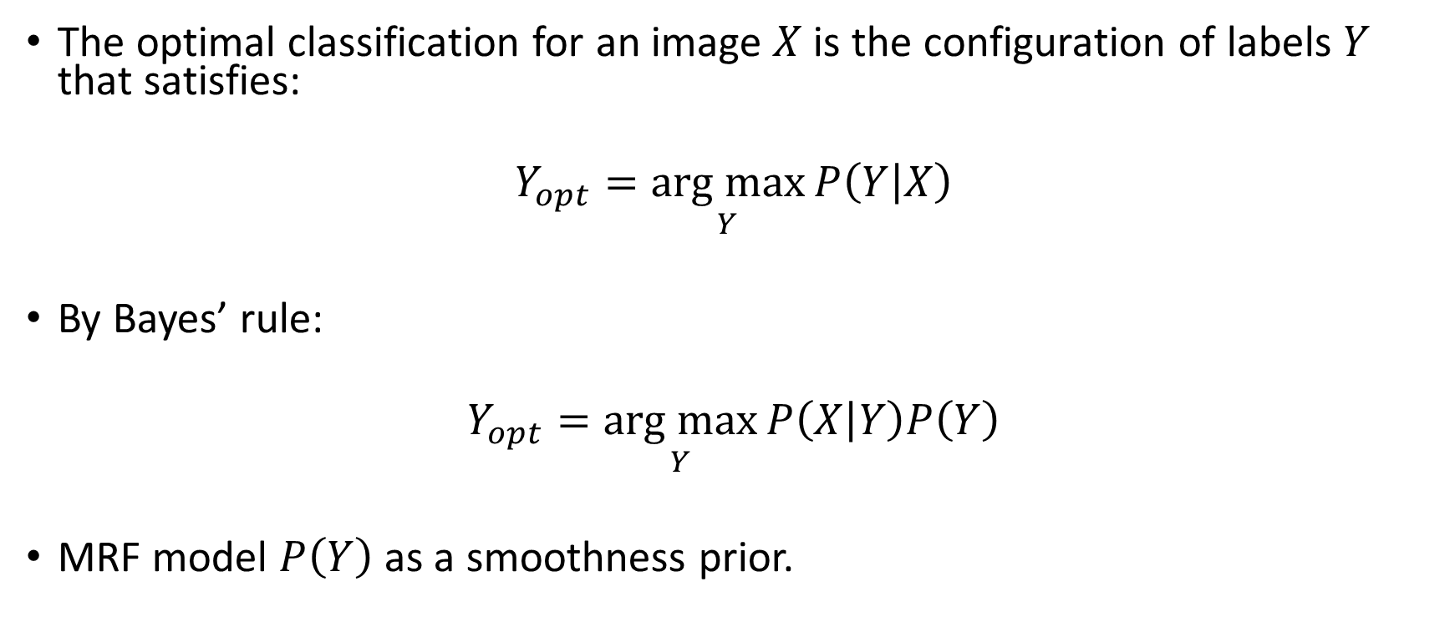
Markov Random Fields
The optimal classification for an image $X$ is the configuration of labels $Y$ that satisfies:
$$Y_{opt}=\underset{Y}{arg max}{P\left(Y | X\right)}$$
By Bayes’ rule:
$$Y_{opt}=\underset{Y}{arg max}{P\left(X | Y\right)P\left(Y\right)}$$
MRF model $P\left(Y\right)$ as a smoothness prior.
Notes:
Bayesian MAP framework

Slide 7
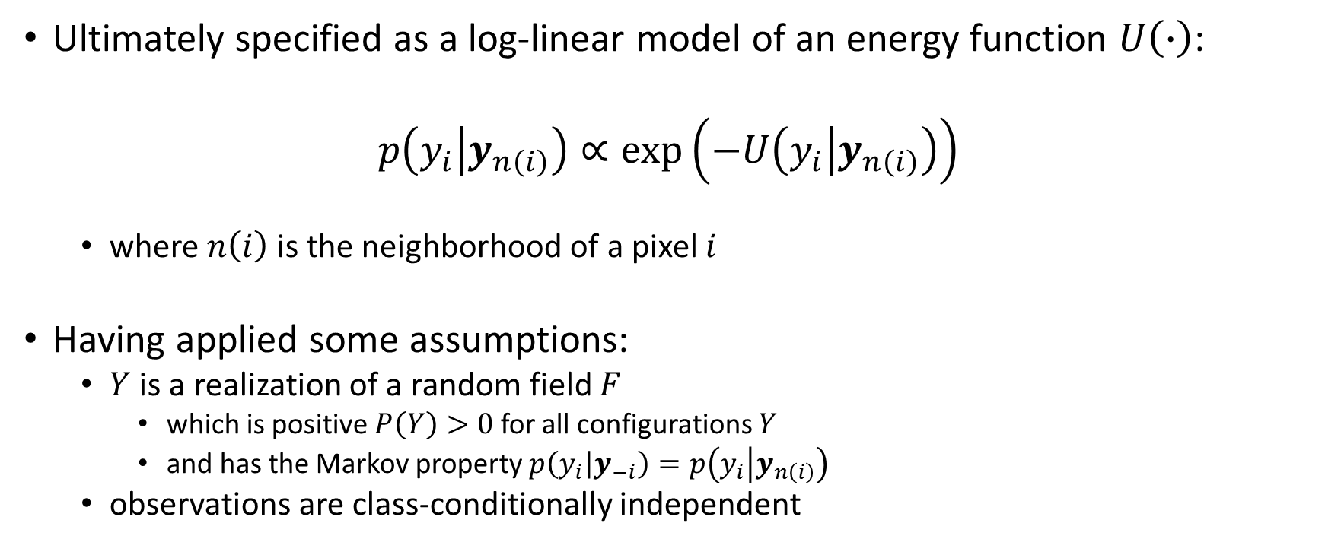
Markov Random Fields
Ultimately specified as a log-linear model of an energy function $U\left(∙\right)$:
$$p\left(y_{i} | y_{n\left(i\right)}\right)∝\text{exp}\left(−U\left(y_{i} | y_{n\left(i\right)}\right)\right)$$
  where $n\left(i\right)$ is the neighborhood of a pixel $i$
Having applied some assumptions:
  $Y$ is a realization of a random field $F$
    which is positive $P\left(Y\right)>0$ for all configurations $Y$
    and has the Markov property $p\left(y_{i} | y_{−i}\right)=p\left(y_{i} | y_{n\left(i\right)}\right)$
  observations are class-conditionally independent
Notes:
point of assumption section: explain what the Markov property is

Slide 8
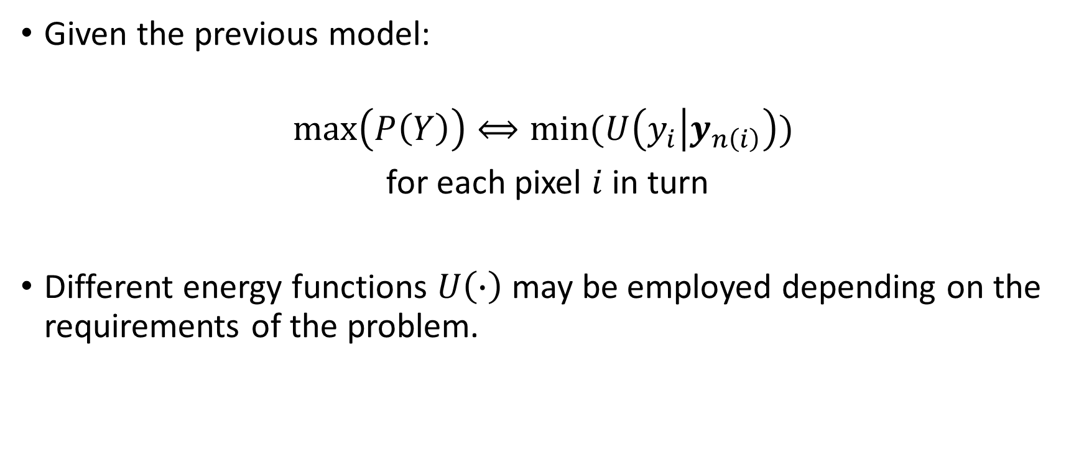
Markov Random Fields
Given the previous model:
$$\text{max}\left(P\left(Y\right)\right)⟺\text{min}\text{(}U\left(y_{i} | y_{n\left(i\right)}\right)\text{) }$$
for each pixel $i$ in turn
Different energy functions $U\left(∙\right)$ may be employed depending on the requirements of the problem.

Slide 9
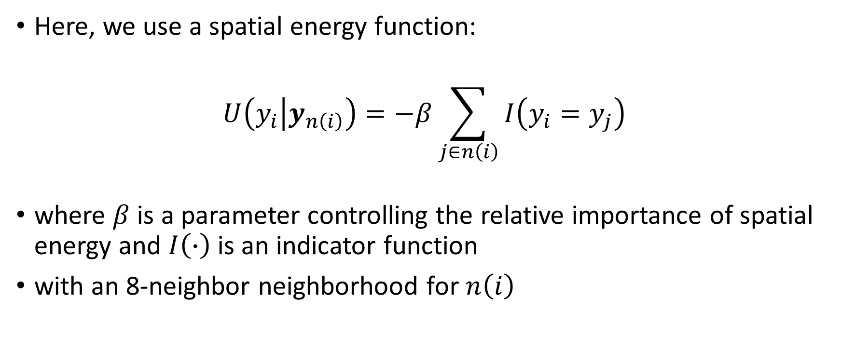
Method
Here, we use a spatial energy function:
$$U\left(y_{i} | y_{n\left(i\right)}\right)=−β\sum_{j∈n\left(i\right)}{I\left(y_{i}=y_{j}\right)}$$
where $β$ is a parameter controlling the relative importance of spatial energy and $I\left(∙\right)$ is an indicator function
with an 8-neighbor neighborhood for $n\left(i\right)$

Slide 10
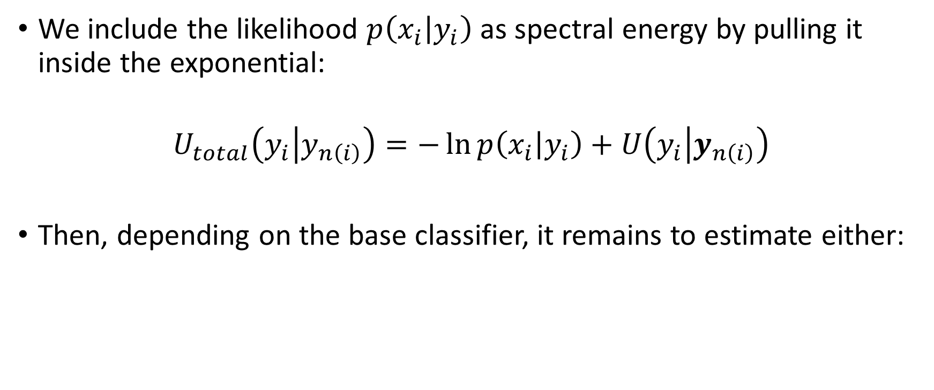
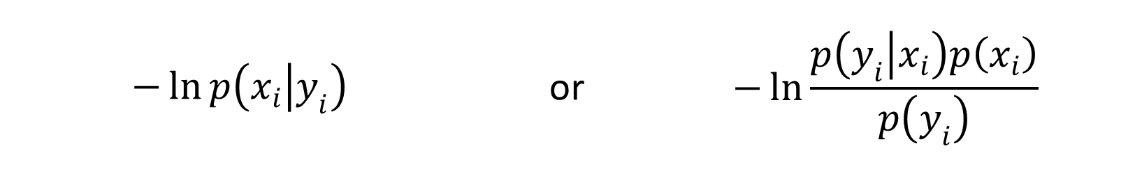
Method
We include the likelihood $p\left(x_{i} | y_{i}\right)$ as spectral energy by pulling it inside the exponential:
$$U_{total}\left(y_{i} | y_{n\left(i\right)}\right)=−\ln{p\left(x_{i} | y_{i}\right)}+U\left(y_{i} | y_{n\left(i\right)}\right)$$
Then, depending on the base classifier, it remains to estimate either:
$$−\ln{p\left(x_{i} | y_{i}\right)}$$ | or | $$−\ln{\frac{p\left(y_{i} | x_{i}\right)p\left(x_{i}\right)}{p\left(y_{i}\right)}}$$
Notes:
goal is to minimize this function
we use the Iterated Conditional Modes algorithm, which is widely employed for its good results at lower computational cost

Slide 11

Methods
We compare three standard approaches to estimating $p\left(x_{i} | y_{i}\right)$ and a recently proposed alternative:
The last approach includes contextual information as features in the kernel function of a Support Vector Machine (see Moser and Serpico 2013 for details):
$$K_{MRF}\left(x_{i},ε_{i};x_{j},ε_{j}\right)=K\left(x_{i},x_{j}\right)+βε_{i}ε_{j}$$
MVN | KDE | SVM | MSVC
Multivariate Gaussian Model | Kernel Density Estimate | Pairwise Coupling by Support Vector Machine | Markovian Support Vector Classifier
Notes:
details of MSVC provided in Moser and Serpico paper

Slide 12
Data
Indian Pines
Salinas
AVIRIS sensor (20 m)
145 x 145 pixel study area
200 features
9 classes
2,296 test pixels
Average total # training pixels:
  2320, 1736.6, 1299.4, 971.2, 725.6, 541, 402.8
  (over 5 realizations)
Original Data Source: Dr. Larry Biehl (Purdue University)
AVIRIS sensor (3.7 m)
512 x 217 pixel study area
204 features
16 classes
13,546 test pixels
Average total # training pixels:
  13512.6, 10129, 7591.4, 5687.8, 4259.4, 3188.6, 2385, 1782.2, 1331, 992.8, 738.6
  (over 5 realizations)
Original Data Source: Dr. Anthony Gualtieri (NASA Goddard)
Notes:
examine accuracy with respect to training set size
averaged over 5 realizations to increase stability of result

Slide 13
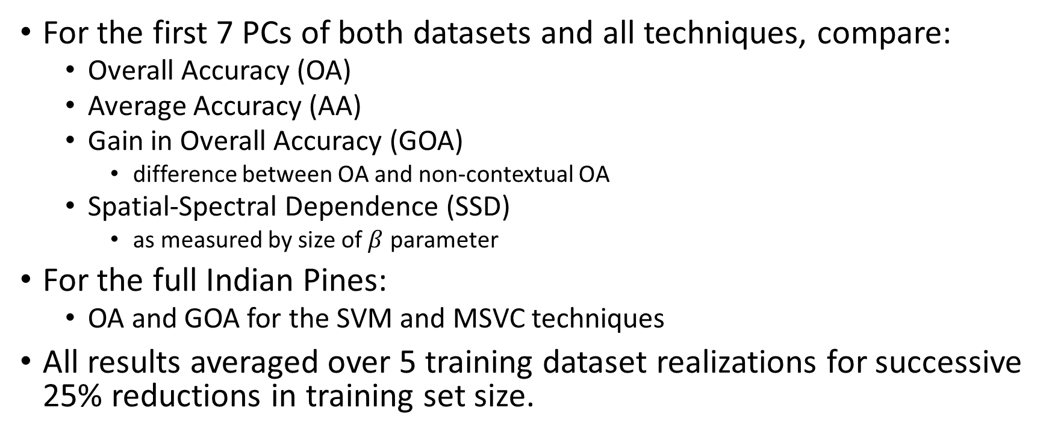
Experiment
For the first 7 PCs of both datasets and all techniques, compare:
  Overall Accuracy (OA)
  Average Accuracy (AA)
  Gain in Overall Accuracy (GOA)
    difference between OA and non-contextual OA
  Spatial-Spectral Dependence (SSD)
    as measured by size of $β$ parameter
For the full Indian Pines:
  OA and GOA for the SVM and MSVC techniques
All results averaged over 5 training dataset realizations for successive 25% reductions in training set size.
Notes:
PCs: principal components

Slide 14
Overall Accuracy (OA)
Notes:
MVN relatively stable, but low performing in both
on Salinas, KDE happens to outperform SVM
MSVC leads mostly in both cases

Slide 15
Average Accuracy (AA)
Notes:
same general pattern as previous
except all but MSVC converge in AA as training set size decreases
Salinas has striking drop for MSVC, even below MVN
Due to confusion between two classes: Grapes (untrained) vs. Vineyard (untrained)

Slide 16
Gain in Overall Accuracy (GOA)
Notes:
MSVC is based on SVM
but SVM is already high-scoring so remarkable that the gain is so large
show significant potential for kernel methods in contextual classification
again, we see that KDE happens to be well-suited to the Salinas dataset

Slide 17
Spatial-Spectral Dependence
Notes:
as sample size decreases, dependence on spatial context increases for distribution-based classifiers
however, opposite relationship for the distribution free SVM classifier

Slide 18
OA and GOA for Full Indian Pines
Overall Accuracy
Gain in Overall Accuracy
Notes:
clear performance increase when using full dataset
with MSVC again showing great promise vs. MRF

Slide 19
Discussion
MVN:
  lowest performing, but stable in accuracy
  lowest computational cost
KDE:
  generally more accurate than MVN and less accurate than SVM
  moderate computational cost
  however, well-suited to Salinas dataset
SVM:
  generally more accurate than MVN or KDE
  high training cost due to parameter selection for RBF kernel
MSVC:
  promising new methodology for MRF-based contextual classification
  highest computational cost

Slide 20
Conclusions
Two thoughts:
  choice of base classifier strongly affects overall classification accuracy
  margin maximization has significant advantages over density estimation
Outlook:
  use of contextual information increasingly relevant with sensor advancement
  joint-use of SVM and MRF is potent classification combination
    better utilizes uses high dimensional data
    better utilizes contextual information when incorporated into kernel function
Future opportunities:
  design more efficient kernel-based algorithms for remote sensing
  extend kernel methodology to spatial-temporal domain
MRF code available at (week after conference):
  http://www.adamwehmann.com/
Notes:
first thought should be obvious to anyone with knowledge of classification
but it’s important to note that contextual information works synergistically with the spectral
and certain techniques provide much greater performance overall
second thought relates to the character of remote sensing data, which is frequently multimodal and non-Gaussian

Slide 21
References
MRF:
  Besag, J. 1986. On the statistical analysis of dirty pictures. Journal of the Royal Statistical Society, Series B 48: 259–302.
  Koller, D. and N. Friedman. 2009. Probabilistic Graphical Models: Principles and Techniques. Cambridge: MIT Press.
  Li, S. Z. 2009. Markov Random Field Modeling in Image Analysis. Tokyo: Springer.
KDE:
  Ihler, A. 2003. Kernel Density Estimation Toolbox for MATLAB. http://www.ics.uci.edu/~ihler/code/kde.html
  Silverman, B. W. 1986. Density Estimation for Statistics and Data Analysis. New York: Chapman and Hall.

Slide 22
References
SVM and MSVC:
  Chih-Chung Chang and Chih-Jen Lin. 2011. LIBSVM: a library for support vector machines. ACM Transactions on Intelligent Systems and Technology 2(3): 27:1-27:27.
  Moser, G. & Serpico, S. B. 2013. Combining support vector machines and Markov random fields in an integrated framework for contextual image classification. IEEE Transactions on Geoscience and Remote Sensing, 99, 1-19.
  Varma, M. and B. R. Babu. 2009. More generality in efficient multiple kernel learning. In Proceedings of the International Conference on Machine Learning, Montreal, Canada, June.
  Wu, T-F., C-J. Lin, and R. C. Weng. 2004. Probability estimates for multi-class classification by pairwise coupling. Journal of Machine Learning Research 5: 975-1005.
MATLAB version 8.1.0. Natick, Massachusetts: The MathWorks Inc., 2013.

Slide 23
Thank you.
wehmann.2@osu.edu
http://www.adamwehmann.com/

Slide 24
Appendix

Slide 25
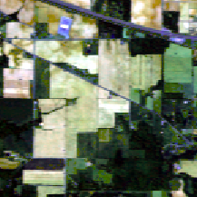
Indian Pines
Class 1: Corn no till
Class 2: Corn min till
Class 3: Grass, pasture
Class 4: Grass, trees
Class 5: Hay windrowed
Class 6: Soybean no till
Class 7: Soybean min till
Class 8: Soybean clean
Class 9: Woods

Slide 26
Indian Pines Training Data
 |  | Class Code
 |  | 1 | 2 | 3 | 4 | 5 | 6 | 7 | 8 | 9
Training Data Level | 100% | 359.8 | 209 | 118.8 | 183.2 | 118.6 | 250 | 618.8 | 142.4 | 319.4
 | 75% | 269.6 | 156.4 | 88.8 | 136.8 | 88.6 | 187.2 | 463.6 | 106.4 | 239.2
 | 56% | 202 | 117 | 66.2 | 102.2 | 66 | 140 | 347.4 | 79.6 | 179
 | 42% | 151.2 | 87.4 | 49.4 | 76.2 | 48.8 | 104.8 | 260.2 | 59.4 | 133.8
 | 32% | 113 | 65.4 | 36.8 | 57 | 36.4 | 78.2 | 194.8 | 44.2 | 99.8
 | 24% | 84.6 | 48.4 | 27.4 | 42.2 | 27 | 58.4 | 145.8 | 32.8 | 74.4
 | 18% | 63 | 36.2 | 20.2 | 31.4 | 20 | 43.4 | 109 | 24.2 | 55.4

Slide 27
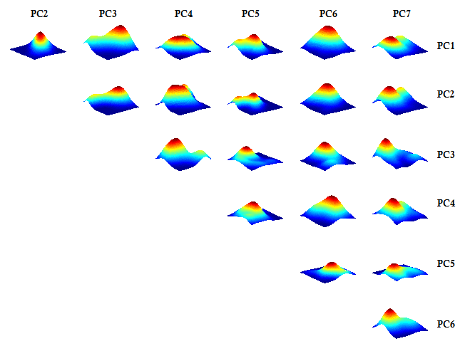
Indian Pines “Corn No Till” Distribution

Slide 28
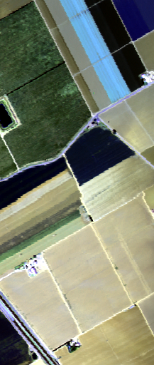
Salinas
Class 1: Broccoli 1
Class 2: Broccoli 2
Class 3: Fallow
Class 4: Fallow (rough)
Class 5: Fallow (smooth)
Class 6: Stubble
Class 7: Celery
Class 8: Grapes (untrained)
Class 9: Vineyard soil
Class 10: Corn (senesced)
Class 11: Lettuce (4 wk)
Class 12: Lettuce (5 wk)
Class 13: Lettuce (6 wk)
Class 14: Lettuce (7 wk)
Class 15: Vineyard (untrained)
Class 16: Vineyard (trellises)

Slide 29
Salinas Training Data
 |  | Class Code
 |  | 1 | 2 | 3 | 4 | 5 | 6 | 7 | 8 | 9 | 10 | 11 | 12 | 13 | 14 | 15 | 16
Training Data Level | 100% | 505.8 | 909.8 | 491.6 | 349.4 | 664 | 987.2 | 885.4 | 2808.6 | 1553 | 830.6 | 263.6 | 486.4 | 235.8 | 279 | 1820.8 | 441.6
 | 75% | 379 | 682 | 368.4 | 261.6 | 497.8 | 740 | 663.8 | 2106 | 1164.4 | 622.6 | 197.2 | 364.4 | 176.6 | 209.2 | 1365.2 | 330.8
 | 56% | 284 | 511 | 275.8 | 196.2 | 373 | 554.8 | 497.4 | 1579 | 873 | 466.4 | 147.6 | 273 | 132 | 156.6 | 1023.6 | 248
 | 42% | 212.6 | 383 | 206.4 | 146.8 | 279.4 | 415.8 | 372.6 | 1184 | 654.2 | 349.4 | 110.4 | 204.6 | 98.4 | 117.2 | 767.4 | 185.6
 | 32% | 159 | 286.6 | 154.4 | 109.8 | 209 | 311.4 | 278.8 | 887.6 | 490.4 | 261.8 | 82.4 | 153.2 | 73.6 | 87.4 | 575.2 | 138.8
 | 24% | 119 | 214.6 | 115.6 | 82 | 156.4 | 233.2 | 208.6 | 665.2 | 367.4 | 196 | 61.2 | 114.6 | 54.8 | 65.2 | 431 | 103.8
 | 18% | 88.8 | 160.8 | 86.4 | 61 | 116.6 | 174.4 | 156 | 498.6 | 275.2 | 146.6 | 45.6 | 85.6 | 40.6 | 48.4 | 323 | 77.4
 | 13% | 66.2 | 120.2 | 64.2 | 45.4 | 86.8 | 130.4 | 116.8 | 373.4 | 206 | 109.8 | 33.8 | 63.8 | 30 | 36 | 242 | 57.4
 | 10% | 49.2 | 90 | 47.8 | 33.6 | 64.6 | 97.4 | 87.4 | 279.8 | 154.2 | 82.2 | 25 | 47.2 | 22 | 26.6 | 181.2 | 42.8
 | 8% | 36.6 | 67.4 | 35.4 | 24.8 | 48 | 72.6 | 65.2 | 209.4 | 115.4 | 61.2 | 18.6 | 35.2 | 16.2 | 19.8 | 135.4 | 31.6
 | 6% | 27.2 | 49.8 | 26.2 | 18.4 | 35.8 | 54 | 48.4 | 156.6 | 86.2 | 45.6 | 13.6 | 26.2 | 11.8 | 14.4 | 101.2 | 23.2

Slide 30
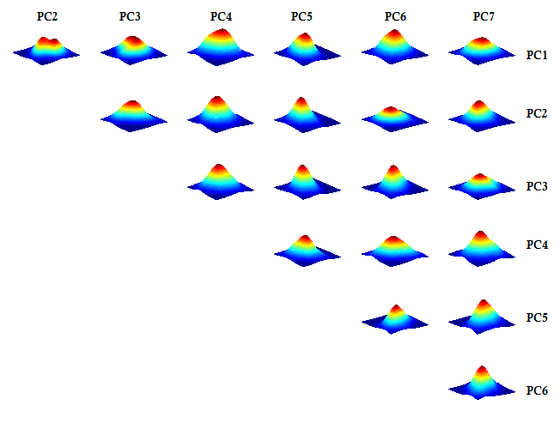
Salinas “Lettuce (5 wk)” Distribution

Slide 31
Algorithm Details
MRF:
  Iterated Conditional Modes energy minimization scheme
  beta parameters chosen via genetic algorithm
    selecting for combination of highest OA and minimum parameter vector norm
KDE:
  Gaussian kernel with bandwidth selected by rule of thumb:
    h = 0.9*A*n^(-1/5), i.e. equation 3.31 in [Silver 1986]
SVM and MSVC:
  RBF kernel used
  cross-validated grid search used for SVM parameter search
    Cost: 2^[-5:2:15], Gamma: 2^[-10:2:5]
  one-vs-one multiclass strategy
MSVC:
  Parameter estimation by Generalized Multiple Kernel Learning [Varma & Babu 2009]

